Slide 1
Chapter 8 – software Implementation
Anh Nguyen-Duc
Tho Quan-Thanh
WEEK 8

Slide 2
Topics covered
Implementation meaning
Coding style & standards
Code with correctness justification
Code smell and some good practices
Code inspection
Exercise

Slide 3
Implementation
Implementation = Unit Implementation + Integration
smallest part that will be separately maintained
put them all together
Notes:
Unit Implementation:
Implementation = programming
Unit = smallest part that will be separately maintained.
Goals:
Satisfy the requirements (specified by the detail design)
Coding goals:
Correctness
Clarity
…?

Slide 4
Golden rule (!?)
Requirements to satisfy Customers
Design again requirements only
Implement again design only
Test again design and requirements
Notes:
Requirements to satisfy Customers
Consultation
No more – no less
Design again requirements only
No more – no less (SRS as a contract)
Implement again design only
No more – no less (SDD = blueprint)
Test again design and requirements
SRS = contract
SDD = blueprint

Slide 5
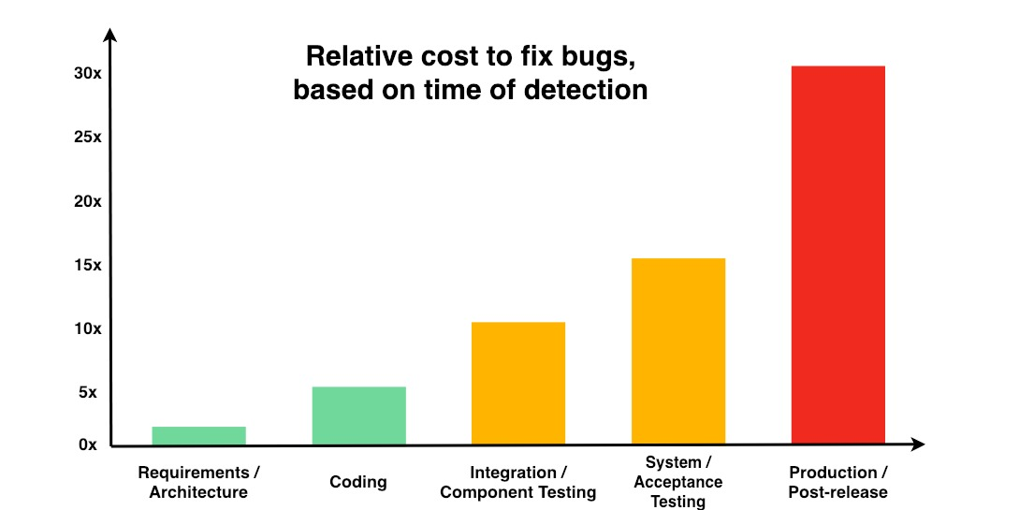
Code quality
Potential saving

Slide 6
Implement Code
One way to ...
1. Plan the structure and residual design for your code
2. Self-inspect your design and/or structure
3. Type your code
4. Self-inspect your code
5. Compile your code
6. Test your code
Notes:
1. Plan the structure and residual design for your code
(complete missing detailed design, if any)
note pre- and post-conditions, the time spent
2. Self-inspect your design and/or structure
note time spent, defect type, source (phase), severity
3. Type your code
apply required standards
code in a manner that is easiest to verify, use formal methods if appropriate
4. Self-inspect your code
convince yourself that your code does the required job, the compiler will never do this for you: it merely checks syntax!
note time spent, defects found, type, source, severity
see the code inspection checklist for details commonly required for method & class construction.
5. Compile your code
repair syntax defects, note time spent, defect type, source, severity , and LOC.
6. Test your code
apply unit test methods, note time spent, defects found, type, source, severity

Slide 7
General Principles in Programming Practice
1. Try to re-use first
2. Enforce intentions
If your code is intended to be used in particular ways only, write it so that the code cannot be used in any other way.
If a member is not intended to be used by other functions, enforce this by making it private or protected etc.
Use qualifiers such as final and abstract etc. to enforce intentions

Slide 8
“Think Globally, Program Locally”
Make all members
as local as possible
as invisible as possible
attributes private:
access them through more public accessor functions if required.
(Making attributes protected gives objects of subclasses access to members of their base classes -- not usually what you want)

Slide 9
Exceptions Handling
“If you must choice between throwing an exception and continuing the computation, continue if you can” (Cay Horstmann)
Catch only those exceptions that you know how to handle
Be reasonable about exceptions callers must handle
Don’t substitute the use of exceptions for issue that should be the subject of testing
Notes:
Catch only those exceptions that you know how to handle
or handle part & throw
outer scope can do so
Be reasonable about exceptions callers must handle
Don’t substitute the use of exceptions for issue that should be the subject of testing
e.g. null parameters (most of the time)
Consider providing
a version throwing exceptions, and
a version which does not (different name)
accompanied by corresponding test functions.
e.g., pop empty stack
“If you must choice between throwing an exception and continuing the computation, continue if you can” (Cay Horstmann)
The game should continue with a default name when given a faulty name
A banking transaction with an illegal amount would not be allowed to continue

Slide 10
Naming Conventions
Use concatenated words
e.g., cylinderLength
Begin class names with capitals
Variable names begin lower case
Constants with capitals
as in MAX_N or use static final
Data members of classes with an underscore
as in _timeOfDay
Use get…, set…., and is… for accessor methods
Additional getters and setters of collections
And/or distinguish between instance variables, local variables and parameters
Notes:
Use concatenated words
e.g., cylinderLength
Begin class names with capitals
Variable names begin lower case
Constants with capitals
as in MAX_NAME_LENGTH, use static final but consider method instead
Data members of classes with an underscore
as in _timeOfDay, or equivalent to distinguish them from other variables since they are global to their object
Use get…, set…., and is… for accessor methods
as in getName(), setName(), isBox() (returns Boolean)
Additional getters and setters of collections
e.g., insertIntoName(), removeFromName().
Consider preceding with standard letters or combinations of letters
e.g., C….. for classes as in CCustomer etc.
useful when the importance of knowing the types of names exceeds the awkwardness of strange-looking names.
or place these type descriptors at the end
And/or distinguish between instance variables, local variables and parameters
_length, length and aLength

Slide 11
Documenting Methods
what the method does
why it does so
what parameters it must be passed (use @param tag)
exceptions it throws (use @exception tag)
reason for choice of visibility
known bugs
test description, describing whether the method has been tested, and the location of its test script
history of changes if you are not using a sub-version system
example of how the method works
pre- and post-conditions
special documentation on threaded and synchronized methods
Notes:
/* Class Name : EncounterCast
* Version information : Version 0.1
* Date : 6/19/1999
* Copyright Notice : see below
* Edit history:
* 11 Feb 2000 Tom VanCourt Used simplified test interface.
* 8 Feb 2000 Tom VanCourt Minor cleanup.
* 08 Jan 2000 Tom VanCourt Change to conform to coding standards
*/
/*
Copyright (C) 2000 Eric J. Braude and Thomas D. Van Court.
This program is the implementation of the case study specified in
"Software Engineering: an Object-Oriented Perspective," Wiley 2001,
by Eric J. Braude.

Slide 12
/* Class Name : EncounterCast
* Version information : Version 0.1
* Date : 6/19/1999
* Copyright Notice : see below
* Edit history:
* 11 Feb 2000 Tom VanCourt Used simplified test interface.
* 8 Feb 2000 Tom VanCourt Minor cleanup.
* 08 Jan 2000 Tom VanCourt Change to conform to coding standards
*/
/*
Copyright (C) 2000 Eric J. Braude and Thomas D. Van Court.
This program is the implementation of the case study specified in
"Software Engineering: an Object-Oriented Perspective," Wiley 2001,
by Eric J. Braude.
/** Facade class/object for the EncounterCharacters package. Used to
* reference all characters of the Encounter game.
* <p> Design: SDD 3.1 Module decomposition
* <br> SDD 5.1.2 Interface to the EncounterCharacters package
*
* <p>Design issues:<ul>
* <li> SDD 5.1.2.4 method engagePlayerWithForeignCharacter was
* not implemented, since engagements are handled more directly
* from the Engaging state object.
* </ul>
*
* @author Dr. Eric Braude
* @version 0.1
*/
public class EncounterCast
{
/** Name for human player */
private static final String MAIN_PLAYER_NAME = "Elena";
/** Gets encounterCast, the one and only instance of EncounterCast.
* <p> Requirement: SDD 5.1.2
*
* @return The EncounterCast singleton.
*/
public static EncounterCast getEncounterCast()
{ return encounterCastS; }
Notes:
/** Facade class/object for the EncounterCharacters package. Used to
* reference all characters of the Encounter game.
* <p> Design: SDD 3.1 Module decomposition
* <br> SDD 5.1.2 Interface to the EncounterCharacters package
*
* <p>Design issues:<ul>
* <li> SDD 5.1.2.4 method engagePlayerWithForeignCharacter was
* not implemented, since engagements are handled more directly
* from the Engaging state object.
* </ul>
*
* @author Dr. Eric Braude
* @version 0.1
*/
public class EncounterCast
{
/** Name for human player */
private static final String MAIN_PLAYER_NAME = "Elena";

Slide 13
Documenting Attributes
Description -- what it's used for
All applicable invariants
quantitative facts about the attribute,
such as "1 < _age < 130"
or " 36 < _length * _width < 193".
Notes:
/** Gets encounterCast, the one and only instance of EncounterCast.
* <p> Requirement: SDD 5.1.2
*
* @return The EncounterCast singleton.
*/
public static EncounterCast getEncounterCast()
{ return encounterCastS; }

Slide 14
Constants
Before designating a final variable, be sure that it is, indeed, final. You’re going to want to change "final" quantities in most cases. Consider using method instead.
Ex:
instead of ...
protected static final MAX_CHARS_IN_NAME;
consider using ...
protected final static int getMaxCharsInName()
{ return 20;
}

Slide 15
Initializing Attributes
Attributes should be always be initialized, think of
private float _balance = 0;
Attribute may be an object of another class, as in
private Customer _customer;
Traditionally done using the constructor, as in
private Customer _customer = new Customer( "Edward", "Jones" );
Problem is maintainability. When new attributes added to Customer, all have to be updated. Also accessing persistent storage unnecessarily.

Slide 16
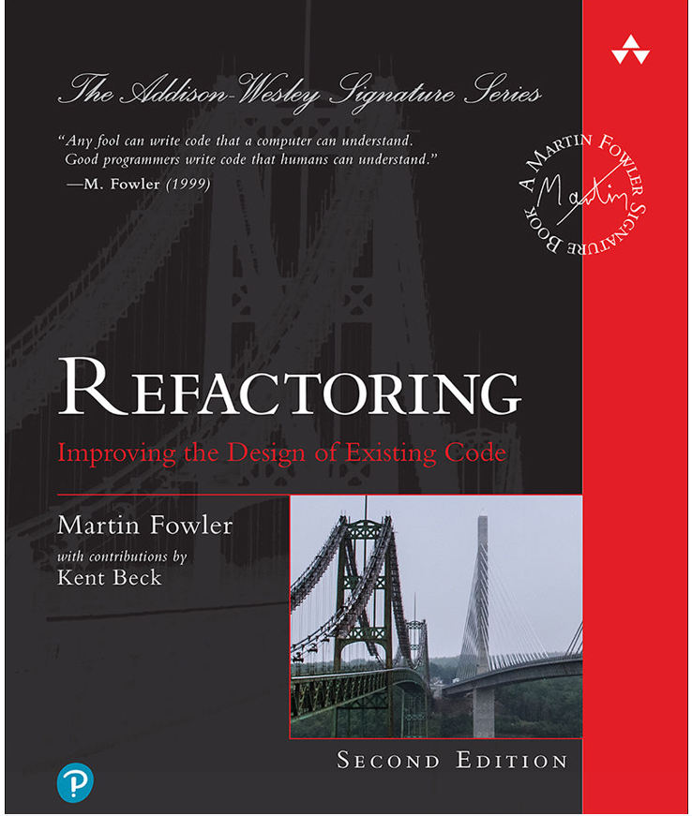
Relevant books
Old edition, available online at NTNU lib.
New edition

Slide 17
Bad smells in code (code smells)
Code smells are any violation of fundamental design principles that decrease the overall quality of the code.
Not bugs or errors
Can certainly add to the chance of bugs and failures down the line.

Slide 18
Cod refactoring goals and properties
Change the internal structure without changing external behavior
Eliminate code smells for
Readability
Consistency
Maintainability
Properties
Preserve correctness
One step at a time
Frequent testing

Slide 19



Slide 20
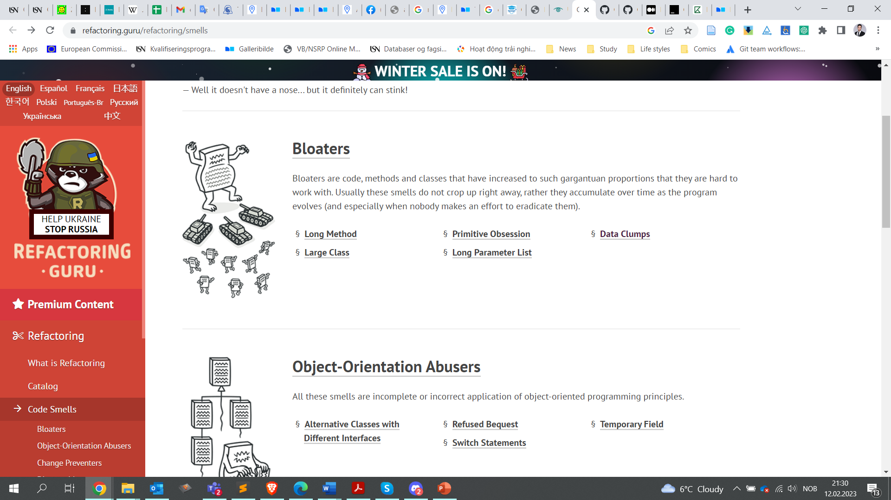
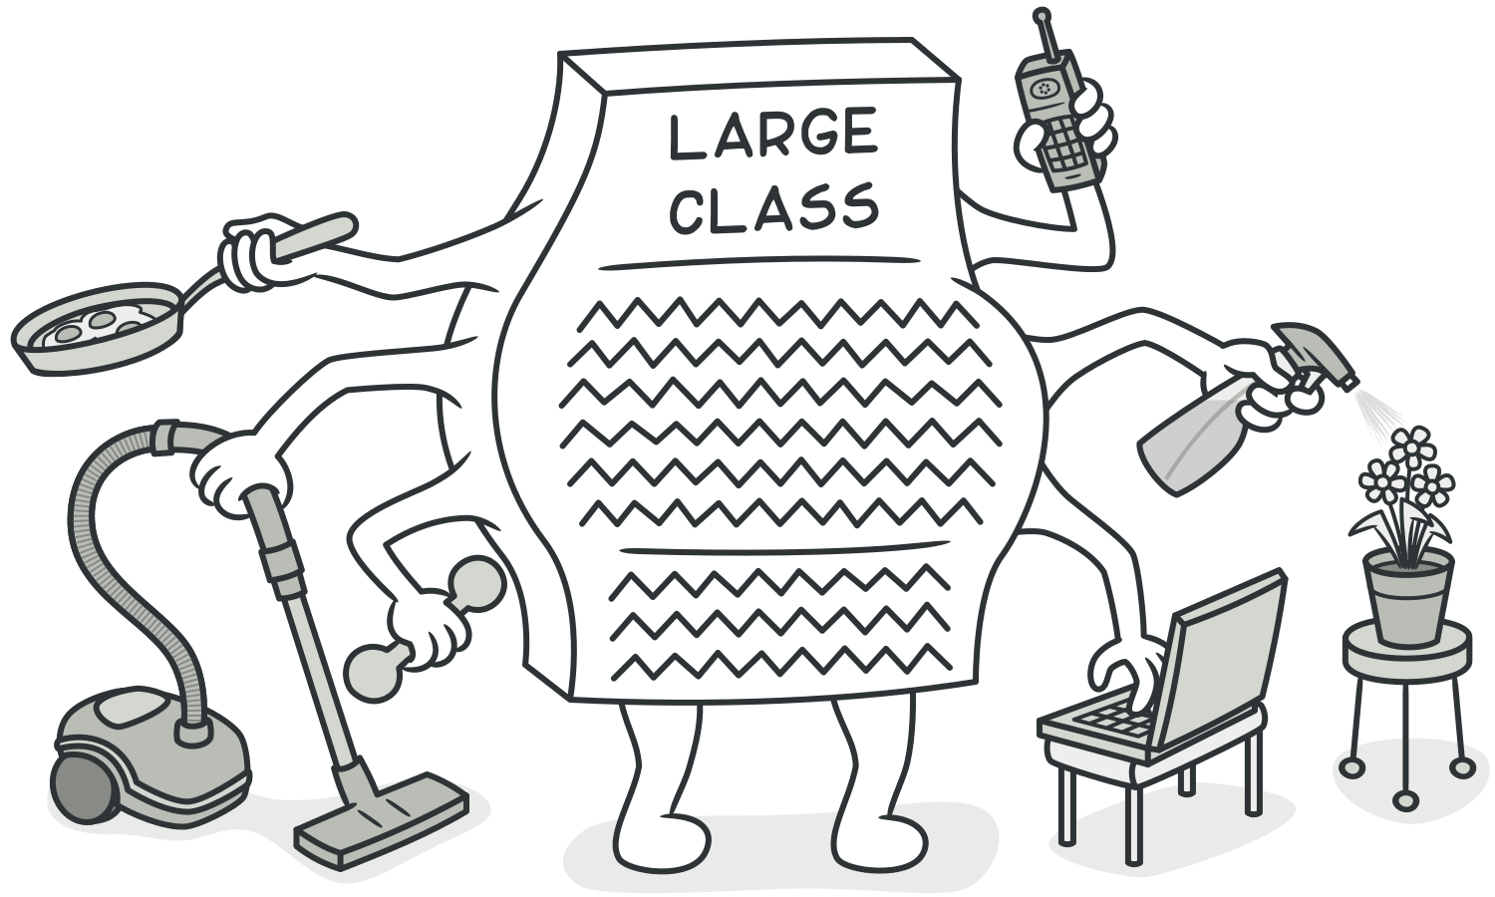


Slide 21
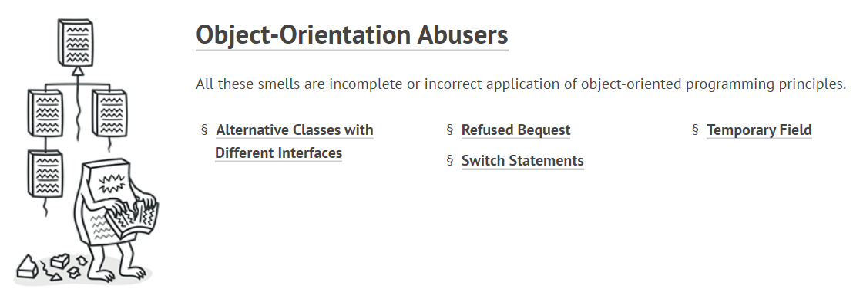
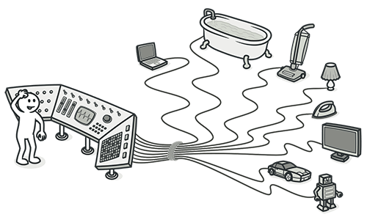

Slide 22
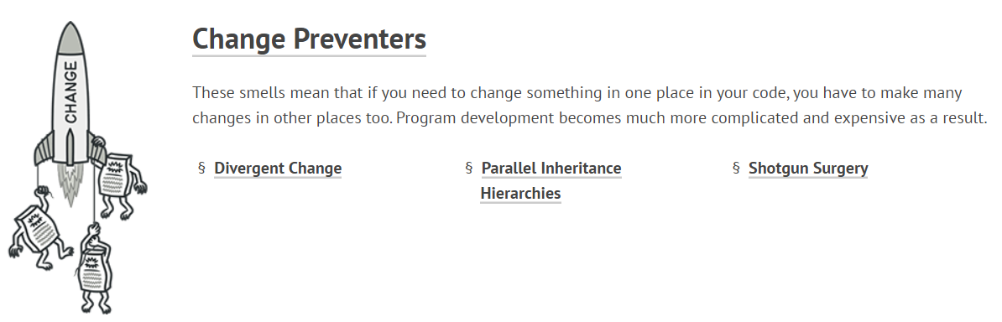
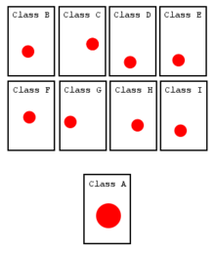

Slide 23
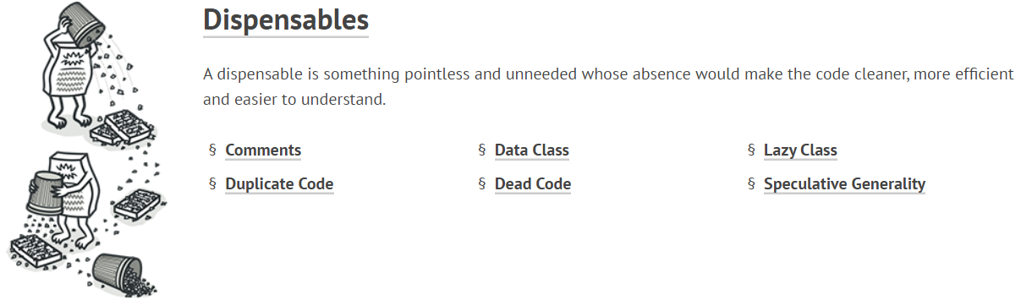
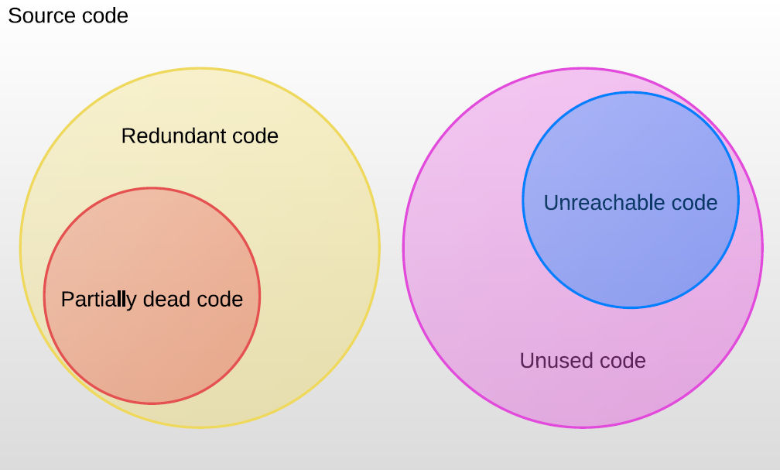

Slide 24
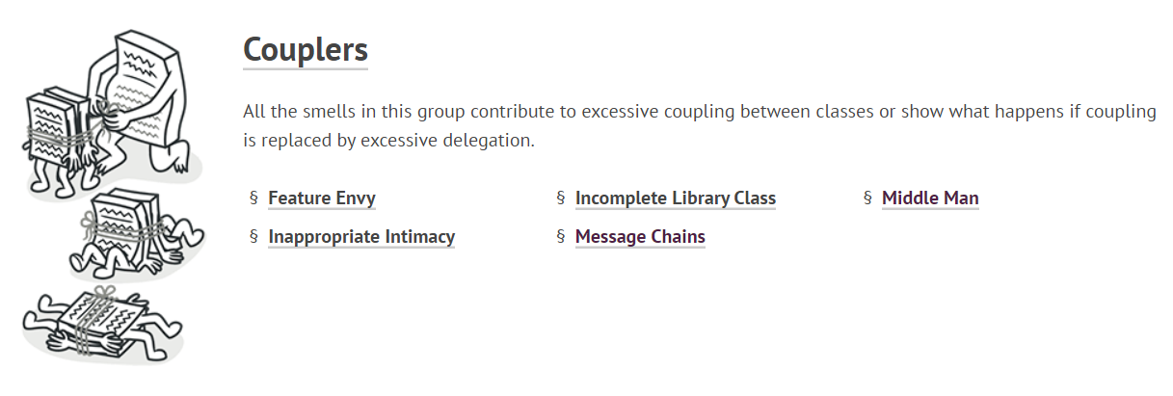
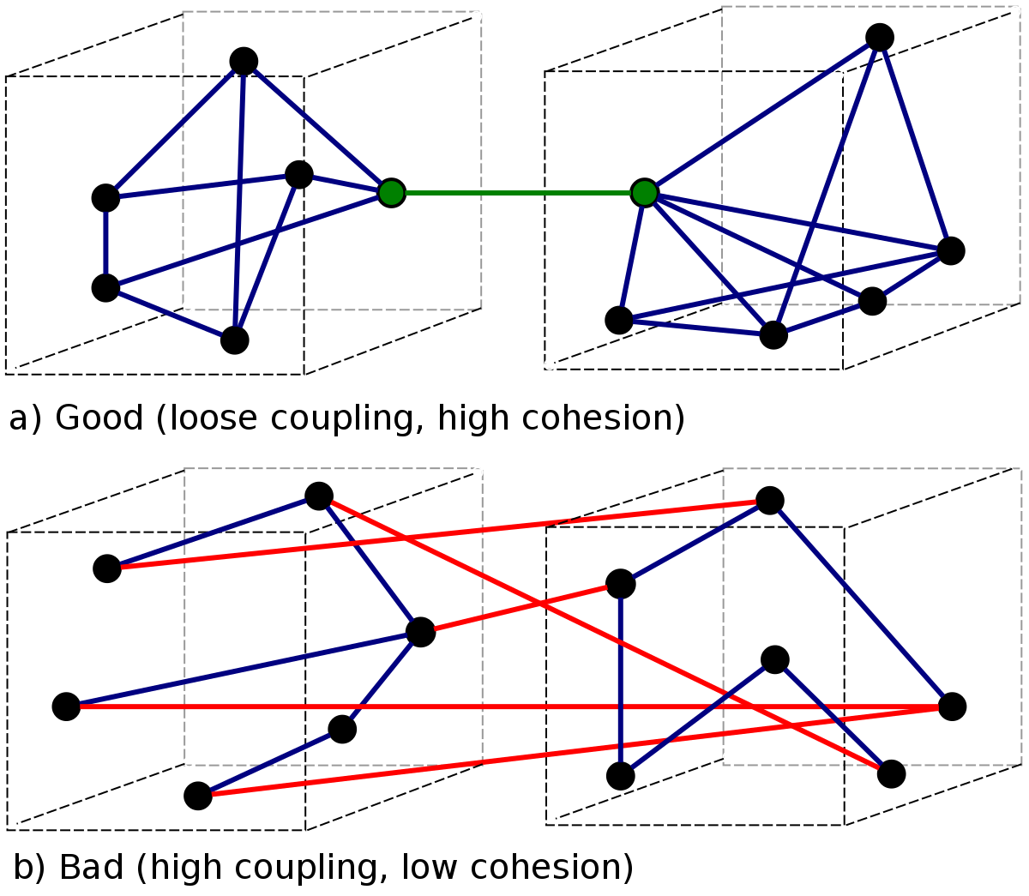

Slide 25
Code refactoring steps
Designing solid tests for the section to be refactored
Reviewing the code to identify bad smells of code
Introducing refactoring and running tests (One step at a time)

Slide 26
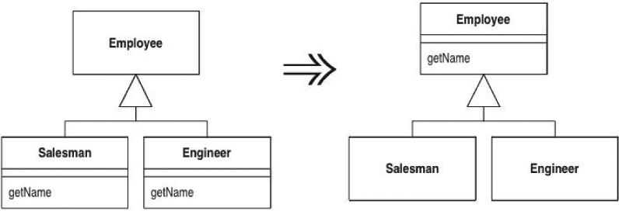
Remove Duplicated Code – Pull up method (Don’t repeat yourself (DRY))
You have methods with identical results on subclasses.

Slide 27
Remove Duplicated code - Substitute Algorithm
You want to replace an algorithm with one that is clearer.
String foundPerson(String[] people){
for (int i = 0; i < people.length; i++) {
if (people[i].equals ("Don"))
{ return "Don"; }
if (people[i].equals ("John"))
{ return "John"; }
if (people[i].equals ("Kent"))
{ return "Kent"; }
}
return "";
}
String foundPerson(String[] people){
List candidates = Arrays.asList(new String[] {"Don", "John", "Kent"});
for (int i=0; i<people.length; i++)
if (candidates.contains(people[i]))
return people[i];
return "";
}

Slide 28
Reduce size – shorten method/class
Long Method
E.g., Extract method
Large Class
E.g., Extract class, subclass, interface
Notes:
: You have a group of parameters that naturally go together. Replace them with an object.

Slide 29
Extract method example
If you have to spend effort looking at a fragment of code and figure out what it is doing, then you should extract it into a function/method and name it after “what.”
void printOwing() { printBanner(); printDetails(getOutstanding());}
void printOwing()
{
printBanner(); //print details
System.out.println ("name: " + _name);
System.out.println ("amount " + getOutstanding());
}
void printDetails (double outstanding) {
System.out.println ("name:" + _name);
System.out.println ("amount:" + outstanding);
}

Slide 30
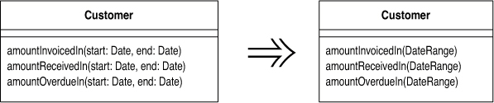
Reduce size – shorten parameter list
Long Parameter List
E.g., Introduce Parameter Object

Slide 31
Divergent Change
Code smell
One module is often changed in different ways for different reasons.
Classes have more than distinct responsibilities that it has more than one reason to change
Violation of single responsibility design principle
Refactoring
You identify everything that changes for a particular cause and put them all together
Notes:
, may lead to large class, deal with the large class afterwards

Slide 32
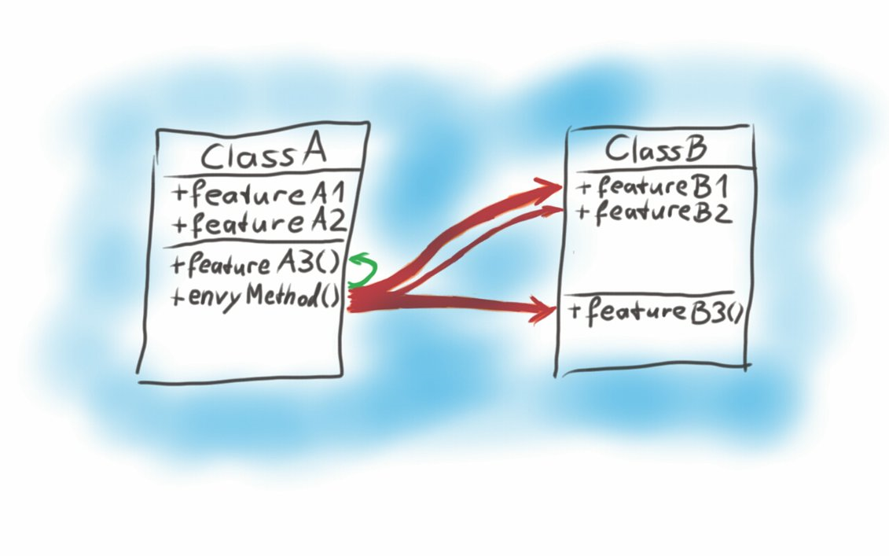
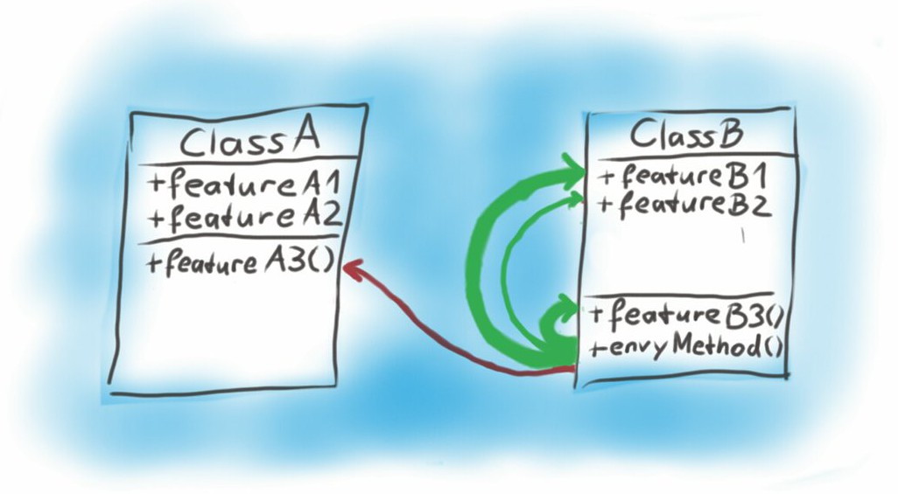
Increase cohesion
Feature envy
A function in one module spends more time communicating with functions or data inside another module than it does within its own module.
Move function to give it a dream home
https://waog.wordpress.com/2014/08/25/code-smell-feature-envy/
Notes:
Feature Envy is a Code Smell which occurs in methods. A method has Feature Envy on another class, if it uses more features (i.e. fields and methods) of another class than of its own. For the method in questions, there is one arrow pointing to each referred feature. Thick arrows mean many uses of the feature, thin arrow stand for less uses. Arrows pointing to the source class are green, while arrows to other classes have one color for each class (red in the example). If the total thickness of one colors arrows, exceeds the total thickness of the green arrows, we have feature envy.
How to handle it?
Give the method what it desires – the other class! Similar to the refactoring for Data Classes, you have to move the methods to its preferred class. For the example above, you have to move envyMethod() to ClassB. The result looks as follows:

Slide 33
Increase cohesion (Cont’)
Data clumps
Bunches of data often hang around together
Consolidate the data together, e.g., Introduce Parameter Object or Preserve Whole Object
int low = daysTempRange().getLow();
int high = daysTempRange().getHigh();
withinPlan = plan.withinRange(low, high);
withinPlan = plan.withinRange(daysTempRange());

Slide 34
Primitive Obsession
Primitive fields are basic built-in building blocks of a language, e.g., int, string, or constants
Primitive Obsession is when the code relies too much on primitives and when uses primitive types to represent an object in a domain

Slide 35
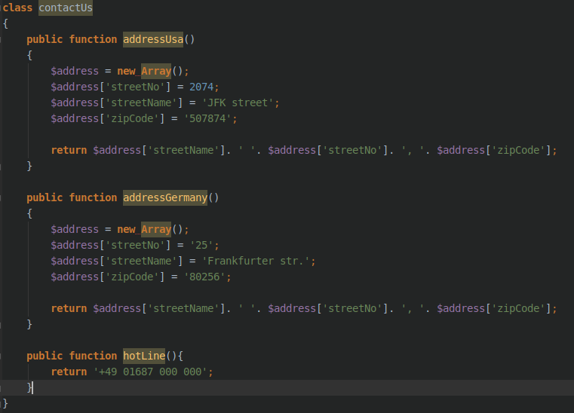
The address is defined as an array.
Every time we need the address we will have to hard code it
https://codeburst.io/write-clean-code-and-get-rid-of-code-smells-aea271f30318

Slide 36
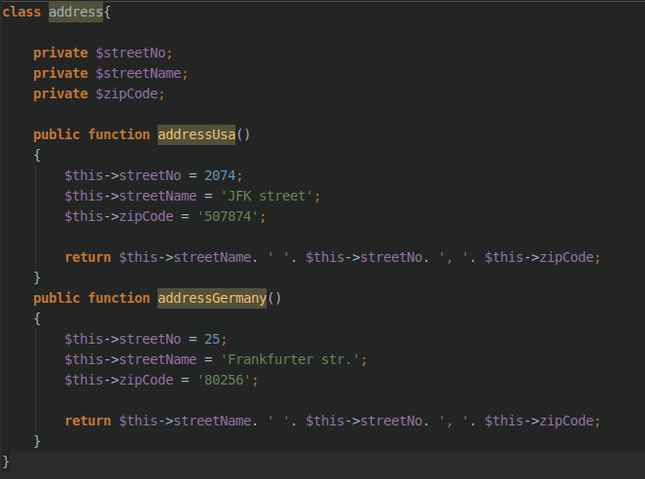
We create a new class called Address
Every time we need to add/edit an address we hit the Address class
https://codeburst.io/write-clean-code-and-get-rid-of-code-smells-aea271f30318

Slide 37
Exercise
https://github.com/anhn/co3001_code_refactoring_lecture

Slide 38
What is inspection?
Visual examination of software product
Identify software anomalies
Errors
Code smells
Deviations from specifications
Deviations from standards
E.g., Java code conventions
www.oracle.com/technetwork/java/codeconventions-150003.pdf

Slide 39
Why do we need inspection?
Many software artifacts cannot be verified by running tests, e.g.,
Requirement specification
Design
Pseudocode
User manual
Inspection reduces defect rates
Inspection complements testing
Inspection identifies code smells
Inspection provides additional benefits

Slide 40
Inspection finds types of defects different from testing
Number of different types of defects detected by testing vs. inspection ^{[1]}
Some defect types | Testing | Inspection
Uninitialized variables | 1 | 4
Illegal behavior, e.g., division by zero | 49 | 20
Incorrectly formulated branch conditions | 2 | 13
Missing branches, including both conditionals and their embedded statements | 4 | 10

Slide 41
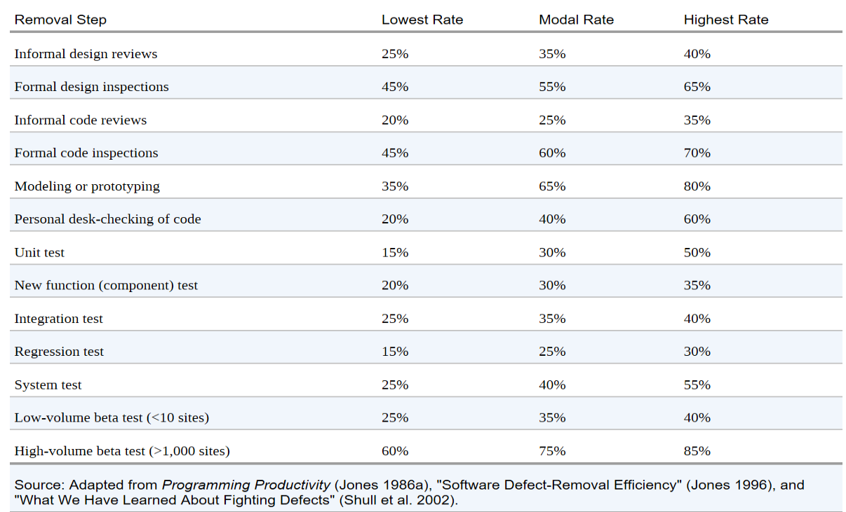
Inspection reduces defect rates

Slide 42
Testing vs. Inspection
 | Testing | Inspection
Pros | Can, at least partly, be automated Can consistently repeat several actions Fast and high volume | Can be used on all types of documents, not just code Can see the complete picture, not only a spot check Can uses all information in the team Can be innovative and inductive
Cons | Is only a spot check Can only be used for code May need several stubs and drivers | Is difficult to use on complex, dynamic situations Unreliable (people can get tired) Slow and low volume

Slide 43
Code review at Google
“All code that gets submitted needs to be reviewed by at least one other person, and either the code writer or the reviewer needs to have readability in that language”
“Most people use Mondrian to do code reviews, and obviously, we spend a good chunk of our time reviewing code”
--Amanda Camp, Software Engineer, Google

Slide 44
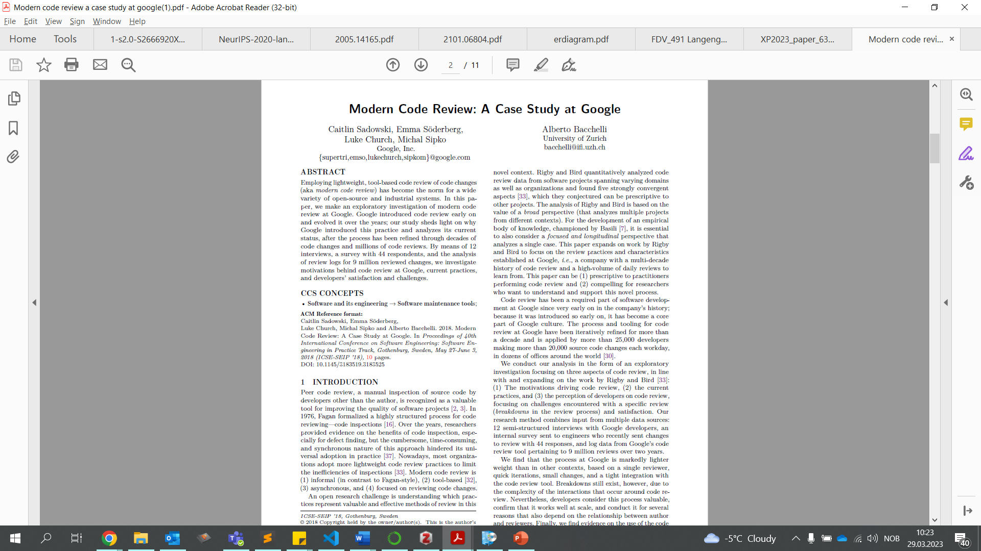
Example of a code review checklist

Slide 45
Inspect Code 1 of 5: Classes Overall
One way to ...
C1. Is its (the class’) name appropriate?
C2. Could it be abstract (to be used only as a base)?
C3. Does its header describe its purpose?
C4. Does its header reference the requirements and/or design element to which it corresponds?
C5. Does it state the package to which it belongs?
C6. Is it as private as it can be?
C7. Should it be final (Java)
C8. Have the documentation standards been applied?
Notes:
C1. Is its (the class’) name appropriate?
consistent with the requirements and/or the design?
sufficiently specialized / general?
C2. Could it be abstract (to be used only as a base)?
C3. Does its header describe its purpose?
C4. Does its header reference the requirements and/or design element to which it corresponds?
C5. Does it state the package to which it belongs?
C6. Is it as private as it can be?
C7. Should it be final (Java)
C8. Have the documentation standards been applied?
e.g., Javadoc

Slide 46
Inspect Code 2 of 5 : Attributes
One way to ...
A1. Is it (the attribute) necessary?
A2. Could it be static?
A3. Should it be final?
A4. Are the naming conventions properly applied?
A5. Is it as private as possible?
A6. Are the attributes as independent as possible?
A7. Is there a comprehensive initialization strategy?
Notes:
A1. Is it (the attribute) necessary?
A2. Could it be static?
Does every instance really need its own variable?
A3. Should it be final?
Does its value really change?
Would a “getter” method alone be preferable (see section tbd)
A4. Are the naming conventions properly applied?
A5. Is it as private as possible?
A6. Are the attributes as independent as possible?
A7. Is there a comprehensive initialization strategy?
at declaration-time?
with constructor(s)?
using static{}?
Mix the above? How?

Slide 47
Inspect Code 3 of 5 : Constructors
One way to ...
CO1. Is it (the constructor) necessary?
CO2. Does it leverage existing constructors?
CO3. Does it initialize of all the attributes?
CO4. Is it as private as possible?
CO5. Does it execute the inherited constructor(s) where necessary?
Notes:
CO1. Is it (the constructor) necessary?
Would a factory method be preferable?
More flexible
Extra function call per construction
CO2. Does it leverage existing constructors?
(a Java-only capability)
CO3. Does it initialize of all the attributes?
CO4. Is it as private as possible?
CO5. Does it execute the inherited constructor(s) where necessary?

Slide 48
Inspect Code 4 of 5: Method Headers
One way to ...
MH1. Is the method appropriately named?
MH2. Is it as private as possible?
MH3. Could it be static?
MH4. Should it be final?
MH5. Does the header describe method’s purpose?
MH6. Does the method header reference the requirements and/or design section that it satisfies?
MH7. Does it state all necessary invariants?
MH8. Does it state all pre-conditions?
MH9. Does it state all post-conditions?
MH10.Does it apply documentation standards?
MH11.Are the parameter types restricted?
Notes:
MH1. Is the method appropriately named?
MH2. Is it as private as possible?
MH3. Could it be static?
MH4. Should it be be final?
MH5. Does the header describe method’s purpose?
MH6. Does the method header reference the requirements and/or design section that it satisfies?
MH7. Does it state all necessary invariants? (section 4)
MH8. Does it state all pre-conditions?
MH9. Does it state all post-conditions?
MH10.Does it apply documentation standards?
MH11.Are the parameter types restricted? (see section 2.5)

Slide 49
Inspect Code 5 of 5: Method Bodies
One way to ...
MB1. Is the algorithm consistent with the detailed design pseudocode and/or flowchart?
MB2. Does the code assume no more than the stated preconditions?
MB3. Does the code produce every one of the postconditions?
MB4. Does the code respect the required invariant?
MB5. Does every loop terminate?
MB6. Are required notational standards observed?
MB7. Has every line been thoroughly checked?
MB8. Are all braces balanced?
MB9. Are illegal parameters considered?
MB10. Does the code return the correct type?
MB11. Is the code thoroughly commented?
Notes:
MB1. Is the algorithm consistent with the detailed design pseudocode and/or flowchart?
MB2. Does the code assume no more than the stated preconditions?
MB3. Does the code produce every one of the postconditions?
MB4. Does the code respect the required invariant?
MB5. Does every loop terminate?
MB6. Are required notational standards observed?
MB7. Has every line been thoroughly checked?
MB8. Are all braces balanced?
MB9. Are illegal parameters considered? (see section 2.5)
MB10. Does the code return the correct type?
MB11. Is the code thoroughly commented?

